Slide 1
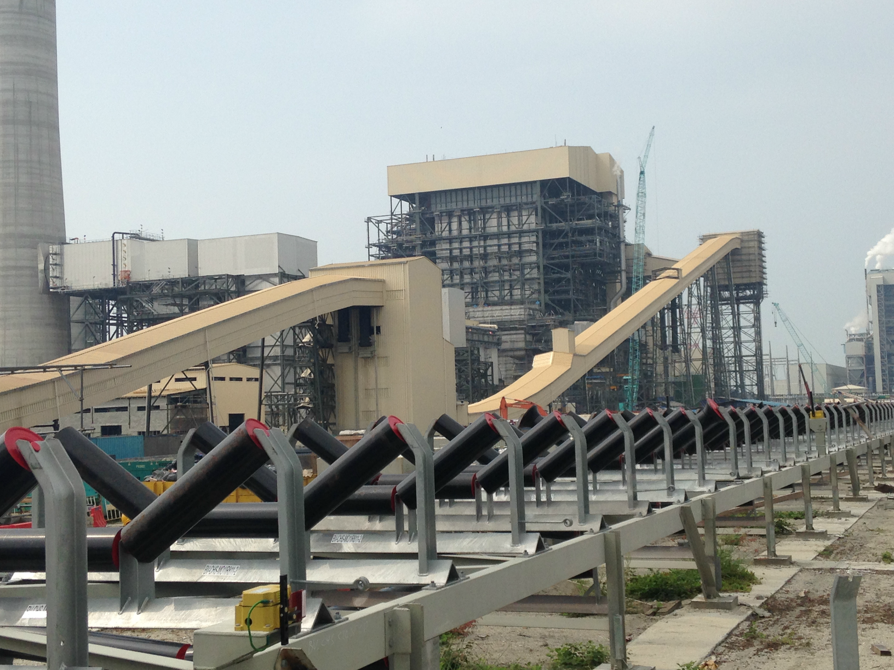

ROKONMA (M) SDN. BHD.

Slide 2
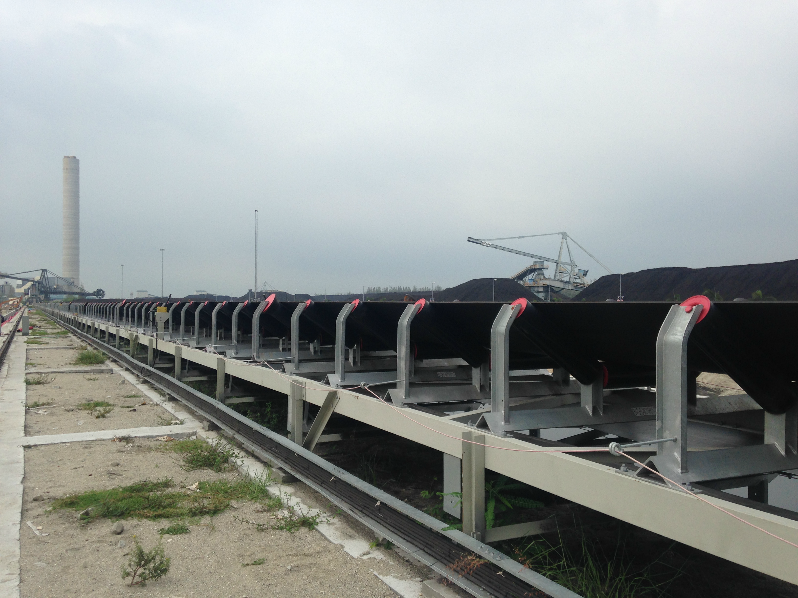
ABOUT US
Founded in 1987, Rokonma (M) Sdn. Bhd. has established itself as a leading manufacturer of high-quality conveyor belt roller components and conveyor systems in Malaysia. The company is committed to delivering reliable, durable, and high-performance products while maintaining the highest standards of quality and customer satisfaction.

Slide 3
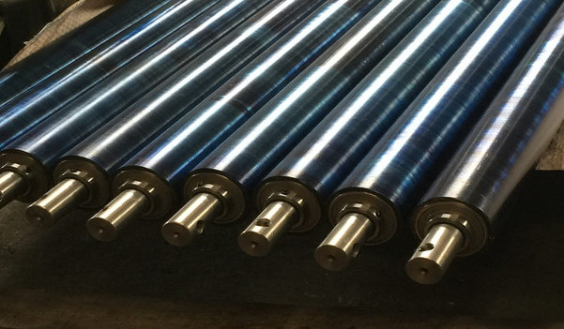
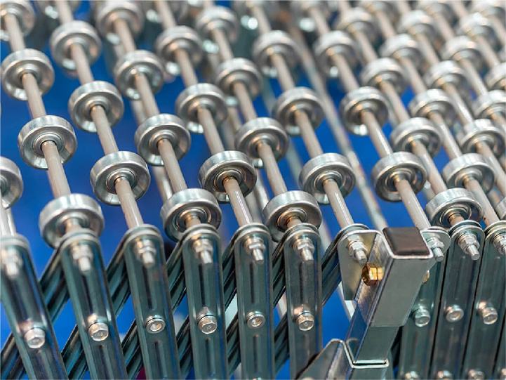
PRODUCTS AND SERVICES
We are specializing in the manufacturing of high-quality conveyor belt roller components, conveyor systems, pulleys, and customize roller fabrication products. In addition to manufacturing, the company also provides professional services including conveyor system design, engineering, and system upgrading solutions to meet various industrial requirements.

Slide 4
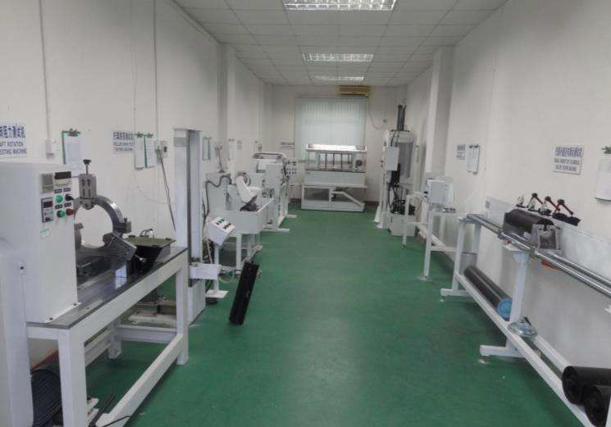

QUALITY CONTROL
We Test:
  Dynamic Balance
  Rim Drag
  Rotation Resistance
  Radial Runout
  Shaft Movement Dislocation
  Shaft Axial Loading
  Water Proof
  Dust Proof

Slide 5
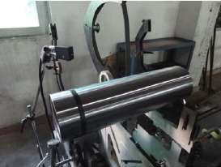
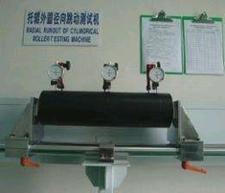
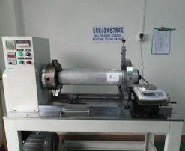
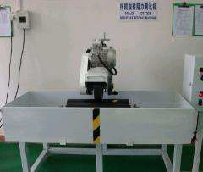
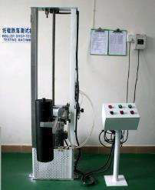
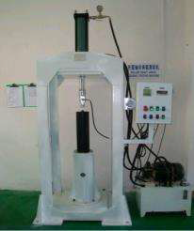
QUALITY CONTROL
Dynamic Balancing
Eccentricity
RIM Drag
Friction
Impact Test
Shaft Angle Load

Slide 6

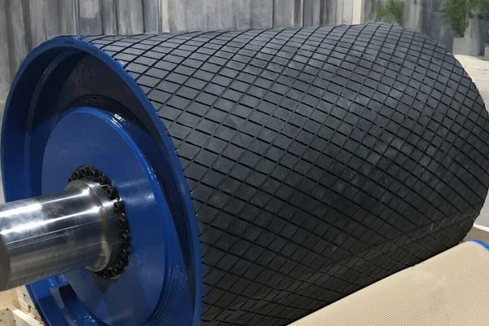
MARKET AND CUSTOMERS
We specialize in serving diverse industries through high-quality conveyor roller manufacturing , while building strong and long-term customer partnerships across local and international markets

Slide 7

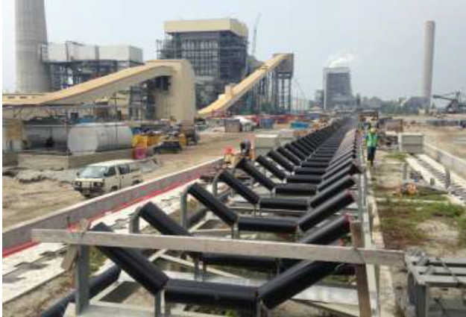
ACHIEVEMENTS
Completed in September 2013, the project supplied approximately 12,000 sets of conveyor idlers for high-capacity material handling systems under the consultancy of Black & Veatch. Products delivered included carry and return idlers, bi-directional training idlers, weigh-quality carry rollers, and impact rollers for conveyor systems with capacities up to 3,500 TPH.

Slide 8

KEY PROJECTS
We have completed significant projects that improved online visibility and engagement for our clients. These projects showcase our ability to deliver effective solutions.

Slide 9
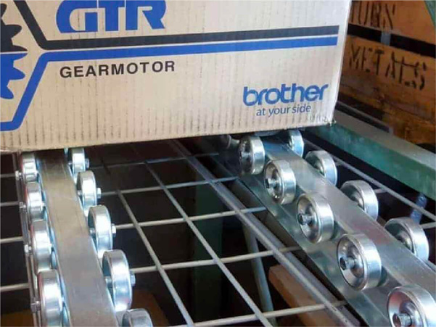
TECHNOLOGY and Innovation
We use advanced technologies like AI-driven analytics, marketing automation tools, and data-driven strategies to enhance efficiency and quality. Our continuous R&D ensures we stay innovative

Slide 10

THANK YOU
+03-7846 2554
www.rokonma.com.my
2, S, Jalan Bukit Badak, Pekan Subang, 40150 Shah Alam, Selangor

